Slide 1
1 a
The unknown creature best fits in the box with group z.
Why is this? I feel as though looking at morphology here justifies it quite well. Well first, it has eyes. So, I think it is fair to exclude group x (even though it has the same looking but longer forelimbs, and it has similar shell/body shape and shell/body markings). Group e does not have the same shell or body shape at all and does not have paired eyes that sit on the head directly. So, I feel as though this excludes group e. Groups c and t have too well-developed forelimbs and have distinct dark shell markings, so this excludes groups c and t. Now let's look at group z, well the arms sort of look like tenacles but not really, the shape of the shells isn’t really the same either. However, it does kind of resemble one of the species’ eyes in group z but I think the oddly shaped shell/body structure with the dotted markings and the tentical front apendages – the similarities between the tentacles and the forelimb and the eyes between it and the one species is not enough. So, I would exclude group z as well.
Well wait a minute… I excluded every group… Well, this is because I think this ? species is another branch from a common ancestor between them. I think this because of the length and location of the forearm being close to that of the tentacles found in group z and also the presence of eyes ties ? to group z. However, I find the look and the location of the forelimb and the shape of the shell/body and markings on the shell/body ties it to group x. So, to add this in the groupings. You would throw it in the blue group, but put groups x and z into their own subgroup within the blue group – just call it the red group.

Slide 2
1 b
I will be answering this as if the original groupings are correct. I have constructed a phylogeny on the next slide that I will reference.
So, the groupings I want to look at first are the separation of groups c and t from groups e, z, and x. I know these are separated because groups c and t are in an orange box and the rest are in a green. So, here we get our first branch in the phylogeny. We know that all the species of the orange box have paired eyes, put a pin in this. Now, lets look at the other side of the phylogeny (following the line away from the orange grouped species). We see that x and z are grouped, and e is by itself. What does that tell us? It tells us that x and z have a common ancestor BUT before that, there was a common ancestor shared between group e and the common ancestor that branched into groups x and z. SO, group e has paired eyes (albeit weird ones but they are paired eyes) meaning that one out of two things happened. 1 – the original common ancestor had no eyes and we had two de novo convergent evolutions for eyes (unlikely) OR the common ancestor had paired eyes or the structure that could form paired eyes in its descendants. Making the eyes seen in groups c and t homologous to group e. Now wait a minute, group z has some eye stuff going on, part fused, and part paired. Ah yes that is true. However, these eye structures are still homologous to the eyes in groups e and c and t that came from the original common ancestor. How do I support this? Well for one, the eyes are in the same place (in the front of the head). Also, if you know anything about the development of eyes – the pathway for creating these bad boys is extremely conserved. I mean, if you even look at the Astyanax mexicanus – they have no eyes because they live in dark caves. However, if you spy on the development of an embryo you will see the eye basically get created and then it gets pretty much destroyed from there. That just reinforces the fact that eyes are not something that just get de novo evolved in their own special way from different structures very often and all the species shown besides groups x have some sort of eye structure that can be traced back to the original common ancestor. So, it is likely that paired eyes evolved once in order for it to be obtained by the common ancestor and then the newer species just put their own reindition on they wanted their sight organ to be (making it all homologous and thus the answer is that it evolved once in order to end up being present in the common ancestor and then the “paired eyes” feature did not undergo convergent evolution because the eyes themselves are homologous across all species.

Slide 3
Phylogeny for Original Groupings after placing species ? From 1 a
Common ancestor
c
t
e
z
?
x
You could even argue that the ? Is the common ancestor of the x and z groups.

Slide 4

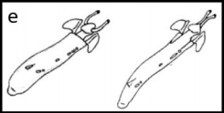



1 a : Original groupings after placing species ? From 1 a?

Slide 5
1 c
Forelimb in group x and ? to the forearms found in groups c and t
In the original group, I hold the opinion that you can argue that the forelimbs of group x and ? are a modified fin like appendage from group e. Furthermore, I think that the finlike projection can be argued to be its own derived structure coming from the back (not the shoulders like the forelimbs in groups c and t). So, I think that the same finlike projection formed and was modified to go forward (I hold this opinion for the tentacles in group z and will argue that in the next point) and act as forelimbs. Also, both the x, ?, c and t groups inhabit land that is somewhat near water. However, I believe that since group x has no eyes, they tend to be less mobile and do not need the finlike structure and traded it for an appendage that works like a normal forelimb – most like the one in group c because there is no “elbow joint”.
Tentacles in group ? and z to forearms found in groups c and t
Like the last point, I argue that the tentacles formed in groups ? and z are derived from the back originated structure (seen as the fin appendage in group e), unlike where the forelimbs in groups c and t originate from. Groups z and ? live where there is plenty of land but also have access to small bodies of where that they could cross to other parts of the land. So, these tentacles preform a dual purpose of functioning like the forelimbs in groups c and t, but not completely deviating from the fin idea that group e had (if you were basing it off the original groupings). It is convergent because the tenacles allow it to be fairly mobile on land like the forelimbs of groups c and t.
Head shaped appendage in group x and nose fin of group t
So, the shape of the head in two of the three species in group t have a nose fin shape. Based on the original groupings, you can argue that the members of group x have an appendage like structure originating from the neck and allowing them to move through water easier as the nose fin of the two members in group t do. This is reasonably reflected in their habitats as there is some water around where they live. Furthermore, it is likely that the eyeless members of group x lived in the bottom of coasts or other bodies of water where they are not exposed to light – justifying the loss of their eyes and their neck appendage being that shape and useful for aquatic locomotion.
Round stocky body shape between groups c and t to groups ? and x
In groups c and t, they are pretty close in the phylogeny and have a short stocky build and the same could be said for groups ? and x. It is not known or assumable that the common ancestor had this body shape. Also, it is not assumable that the bodies of c and t have a shell or not shell, and the same is true with groups ? And x. So, we only have shape to go off and since there are so many unknowns, you cannot confidently say that these body shapes evolved from the same exact structure/genetic pathways. However, you can say that these body shapes would serve similar functions for survival in the species. So, based on that, it is very possible that this roundish stocky build between these sets of 2 groups is an example of convergent evolution.

Slide 6
1 d : New groupings

Slide 7
Phylogeny version of my groupings for 1 d
Common Ancestor
x
z
?
c
t
e
You could even argue that the ? Is the common ancestor of the x and z groups.

Slide 8
2
Okay, So I am going to snip the map over to my power point and annotate it a bit and refer to it. I will place it on the next slide.
I think the two species circled in red underwent vicariance because they are in the same grouping (so they are similar evolutionarily) and they are separated by a body of water. If the two land masses that they inhabit were moved together, they would be living in a continuous similar habitat. I think that the land masses moved apart, creating an uninhabitable region – which is the strip of water that now separates them – and that split up the population. They then further evolved and speciated to live in their new subpopulations.
For dispersal, I think it is smart to look to the islands. As we learned, islands get inhabited via dispersal (immigration). There is an island that has a member from group t that is close to a portion of mainland that also has a member from group t in it. I have them circled in blue om the next slide. The probability of dispersal to island is impacted by its distance to the mainland, so this made me consider the island that I have circled in yellow. It also has a member from group t and is closer to the mainland than the one I have circled in blue. The reason that I went with the island that is a litter further out is due to the fact that the mainland group t species is shown to live closer to the coast facing the island circled in blue. However, it is also very likely that this species ended up on the yellowed circled island via dispersal, but I am going with the blue circled island even though it is further away because the area that the mainland species lives is closer to the shore facing that island. Meaning that it is more likely for them to get blown out to sea that way instead of being blown across land and then into the sea and then to the island.
Also the blue island is bigger so that plays a very very very small role in increasing dispersal probability just because it is a bigger target. This is likely essentially negligible though but I thought I would include it.

Slide 9
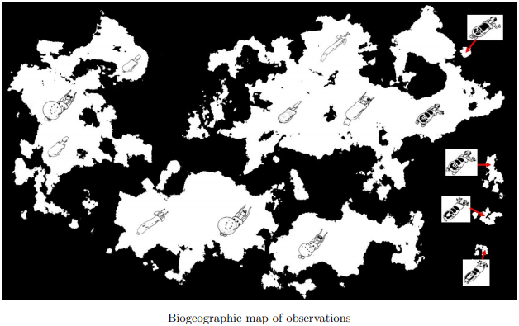
2 Vicariance and Dispersal Labeled
Dispersal
Vicariance

Slide 10
3
Okay, I want to lay out some rules so I can refer to them without the need of explanation.
First, superposition. This one is simple, what is on top is new and what is on the bottom is older. So, for each respective rock column the top of the column is new relative to the rocks on the bottom of the column.
Next, horizontality. This one is still pretty simple but a little hard to picture. This states that everything must have been first laid horizontality.
Cross-cutting relationships. This just means that whatever is cutting through is newer – kind of just follows superposition in a way.
Lateral Continuity. This builds on the previous two rules. This states that rocky layers should be continuous in the way that if you cut through a mountain – each side of the hole should have the same rock layer – like a layered cake.

Slide 11
3
The first thing that should be done, is to find out which fossilized creatures are still alive. Why should this be done? Well, if the exact same creature that is fossilized is still alive, it is more likely that those fossils are most recent – due evolution not changing the morphology enough to make it seem as though it is a new species or it actually becoming so different it does speciate. The only fossils we have of living specimens are L, O1, and Q2. So, these should be closer to the top.
So, this gives us an idea of what column should be near the top.

Slide 12
3
Now, another thing we need to discuss about stratigraphic columns.
You can match the rock layers by rock environment and what fossils are present in that rock environment. We can do this because, if the same fossils are found in the same environment in two different columns – you can declare those two respective layers the same age. We can do this because of the lateral continuity rule.
So, draw lines from the rock layers of one column to a rock layer of another column where the fossils and environment (rock type) is the same.

Slide 13
3
So, to start determining relative age, let us look at the column that contains some of the living specimens as fossils first. We are going to state that, due to superposition, the top of this column is the youngest fossil relatively. So, we should see if other columns have fossils that match.
From these lines, we can begin to see what the relative age of the other rock layers are in the other columns and based on their positions in their respective column we can kind of get an idea of the age of the entire rock column and the rock layers individually.

Slide 14
3
So, based on superposition and the strategy of putting the fossils of living specimen near the top, we can conclude that the newest fossils are K, L, M in order from newest to oldest.
However, it is that simple – now we need to add in the other columns. So, rocky layer A matches environments and fossils with M. So, M and A are likely the same relative age. Same goes for P to N and Q to O. So P = N and Q = O.
New order is K, L, M/A, N/P, O/Q.

Slide 15
3
So hey, we’re coming along – making some progress. Now, we have to repeat this process while keeping superposition in mind.
Let’s state a few facts, that when cumulated, might help us figure out some more positions. So, the top of the column that starts with A has a connection to the 3rd layer in the youngest column and it is the 1st position of that column that makes this connection. The column that starts with P has a connection with its 1st layer (P) to the 4th layer of the youngest column (N) and with its 2nd layer (Q) to the 5th layer (O) of the youngest column.
So, A is younger than P and Q because of superposition of the youngest column. A is the first layer in its column and P the first of its column, and A connects with the 3rd layer and P the 4th layer of the youngest column – making A younger than P. P is younger than Q because of superposition in its own column.

Slide 16
3
So, let’s look at our order from youngest to oldest as of now.
K, L, M/A, N/P, O/Q, A, P, Q
Now, we must look at the relative ages of the rest of the rock layers within the columns starting with A and P. The reason you know that these layers are younger than the layers of the columns starting with F and U is because F matches with E (E is the oldest layer in the column starting with A) and U matches with T. So, now the task is matching the relative ages of those two columns. Let’s look at what they have in common. A’s column has its 3rd position matching with the 4th of the P column and also A has its 4th position matching to the 5th position of the P column. Why does this matter? Well, superposition is why.
So, let’s throw some more positions in.

Slide 17
3
So how do I apply superposition here in order to mark down some more positions? We know C and S and D and T are the same age respectively. With that information, we can get the relative age of below and above where these layers are in their column. For instance, E is going to be older than T because it is under D in the A column. Also, U is going to be younger than E and F because E and F are the same age, and they fall below D in their column and D is the same as T and T shares the environment and one fossil with T – suggesting it is younger than E and F.
Current Positions
K, L, M/A, N/P, O,Q, A, P, Q, B, R, C/S, D/T, U, E/F,

Slide 18
3
Now, you may be asking – how did you place B and R? That is a good question. Since there is no direct connections, it makes it harder to place these. We know that Q is younger than it because it matches with the earliest column and we know that it is younger than both C and S because of superposition and there is a connection between them to across columns. So that leaves R. R and B both are in a position where deducing their relative ages are not so clear. We know that they belong in one of two spots but in what order? My justification for putting B before R is by looking at the fossils themselves. The fossil in R looks more similar to the fossil in C and S than the fossils in B do. So, based on it is not far fetched claim that R is closer in age to C and S and that means it is older than B.

Slide 19
3
So, we now have the last 4 of the last 2 columns to place. The connections here are a little less obvious. We know that U is younger than F, which was explained earlier. Then, the 2nd position in the F column shows the same environment and the same fossil as the 3rd and 5th position in the U column. So, here is a less obvious but important idea – otherwise we couldn’t truly age the last few remaining ones. So, we can say that the 2nd position in the U column is the roughly the same age of somewhere between the 5th and 2nd position. I personally place it closer to the 5th position. I do this because if this is the case, we know that V, W, and X come before G and Y. Due to the fact that this fossil in G and Y is stretched through across 3 layers (occupying 2 of them), we cannot confidently say that G and Y are the same age. In this case, it is more likely that G is a bit younger than Y due to there being more of a range found in the U column. So, the likelihood of the older fossils being representing in a column is higher in column U.
Current Positions
K, L, M/A, N/P, O/Q, A, P, Q, B, R, C/S, D/T, U, E/F, V, W, X, G, Y, H, I, J

Slide 20
3
Final Positions
K, L, M/A, N/P, O/Q, A, P, Q, B, R, C/S, D/T, U, E/F, V, W, X, G, Y, H, I, J

Slide 21
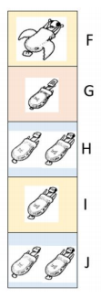
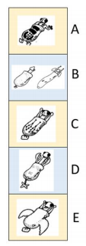
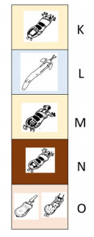
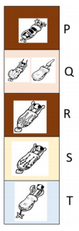
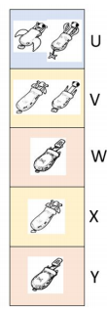
Notes:
, , L, O1, Q2
A, B2, C, D, E, F, G, H, I, J, K, M, N, O2, P, Q1, R, S, T, U, V, W, X, Y

Slide 22
